Slide 1
UMKC Attendance & Feedback Portal
Team 6(Mavericks):
Thammaneni Pragathi
Sridevi Mallipudi
Fatema Hasta
Kranti Dodla

Slide 2

UMKC Attendance & Feedback Portal
A Web portal is an exclusively designed web application that can provide information from different sources and the content that displayed varies depending upon the intended user and the intended purpose.
The existing UMKC Attendance Application enables students to submit code for attendance submission.
This existing application can be enhanced as a web portal for the students to register. Depending upon the term and courses enrolled, students can easily have access to view the calendar, corresponding schedule for the date and submit the feedback for their presence. Each professor can pull out information regarding the attendance and feedback.
So, the main agenda of this is to create a portal collectively which makes it flexible for students to submit the attendance & feedback instead of spending time in fetching links of the forms and submitting it externally.

Slide 3
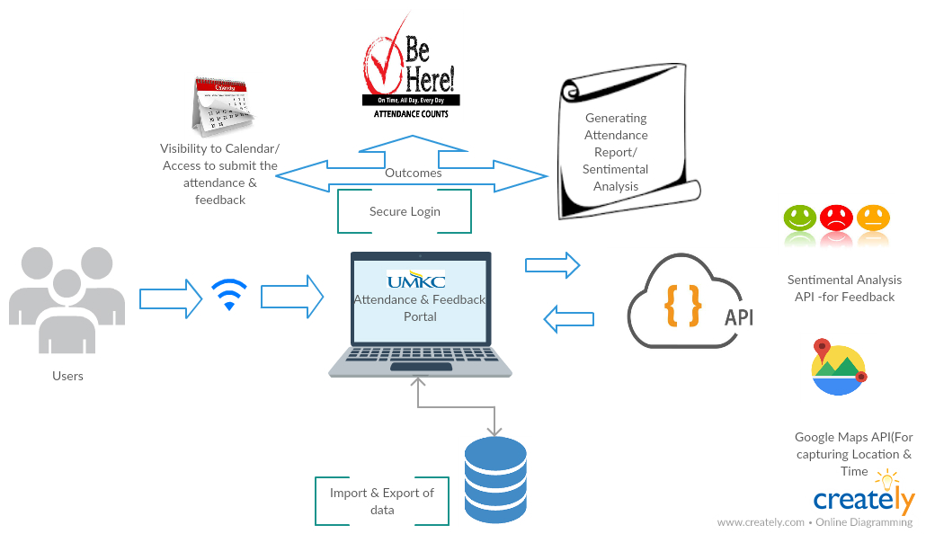
Architecture Diagram:

Slide 4
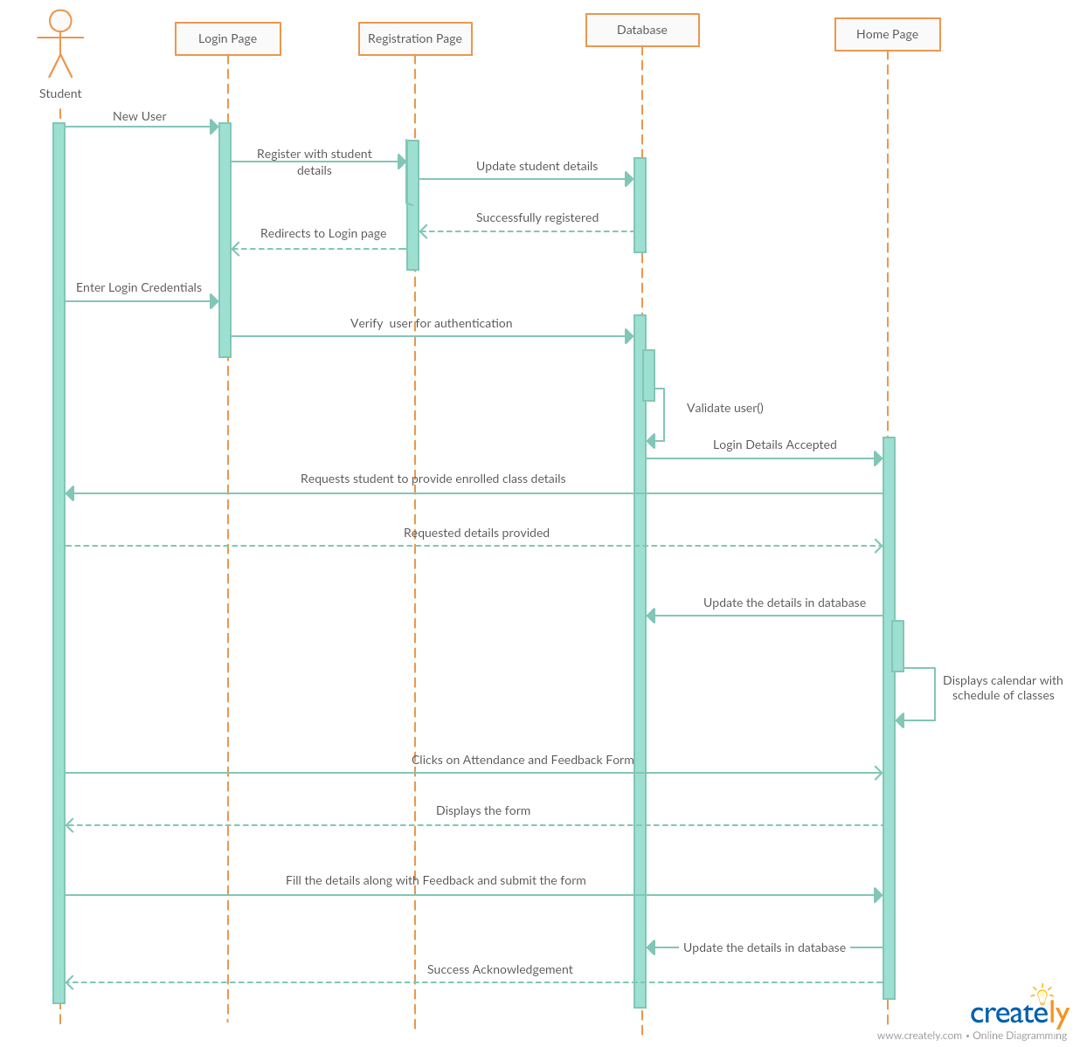
Sequence Diagrams:
Corresponding Sequence diagram explains the sequence of each flow with respect to :
Student Activities

Slide 5
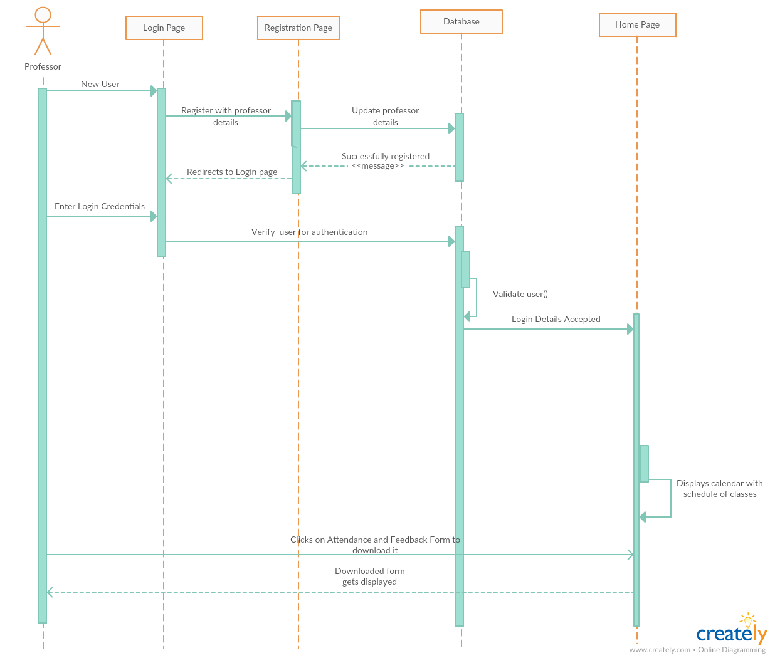
Sequence Diagrams:
Corresponding Sequence diagram explains the sequence of each flow with respect to :
Faculty Activities

Slide 6
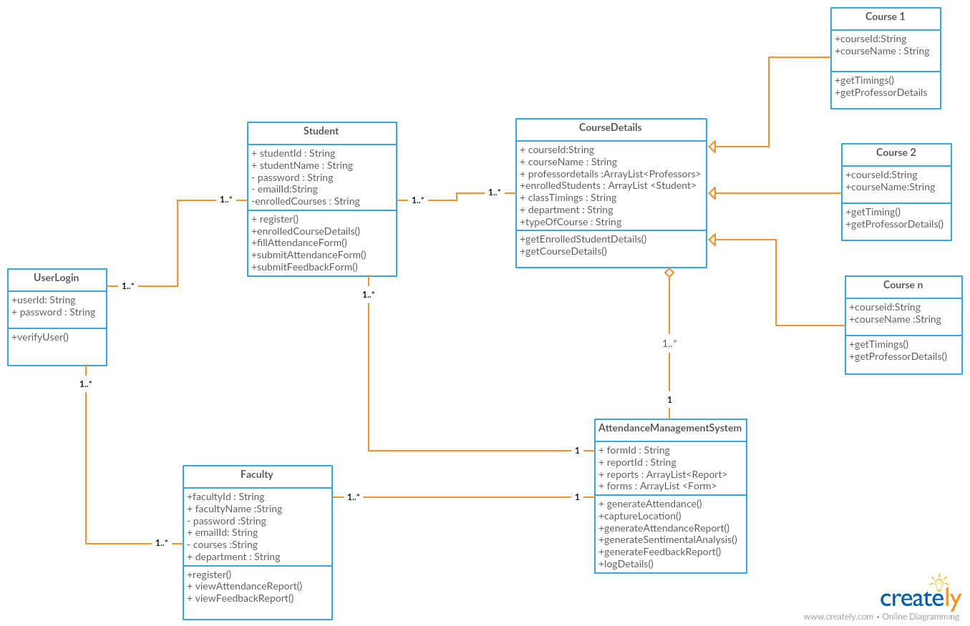
Class Diagram :
The corresponding Class Diagram defines the static structure of the UMKC Attendance & Feedback portal application.

Slide 7
Features :
1.Login/Register Pages: Student, Professor Login/Registration Pages.
2. Authentication Via OTP & Pop-up Dialog box for details regarding courses enrolled.
3. Scheduled calendar page which allows students to view their schedule for the courses enrolled and submit attendance/feedback forms.
4. Location and time capture through API’s for the feedbacks
5. Sentimental Analysis for feedback submitted by students.
6. Database (MongoDB) to store the details – Student , Faculty, Courses, Feedback collections
7. Auto generating the reports of attendance/feedback for the professors .

Slide 8
Significance & Outcome :
Significance:
Flexible and quick submission of attendance and feedback using a single form access rather than submitting multiple forms explicitly.
Improved accessibility to track and manage student attendance and feedback.
Positive and negative feedback analysis.
Location and Time tracking of each submission.
Out Come :
The outcome of this application is easily accessible and collectively helps students and professors with an easy submission, tracking the feedbacks with a single login instead of searching the links and submitting each form.

Slide 9
Technologies Used:
HTML,CSS and Bootstrap
JavaScript , Angular JS and Node JS
Mongo DB for Data Storage
Geo Location capturing
Sentimental Analysis- Watson API
Google Charts API for Visualization
Google App Script Runner for Calendar generation with recurring events

Slide 10
Thank you…

